Slide 1

MIE 1624 Project Presentation
Course
Group 22: Neil Juan, Tyler Rankin, Lei Lei, Ke Ren, Raghavendran Thiruvengadam, Arun Shanmugam
Compass

Slide 2
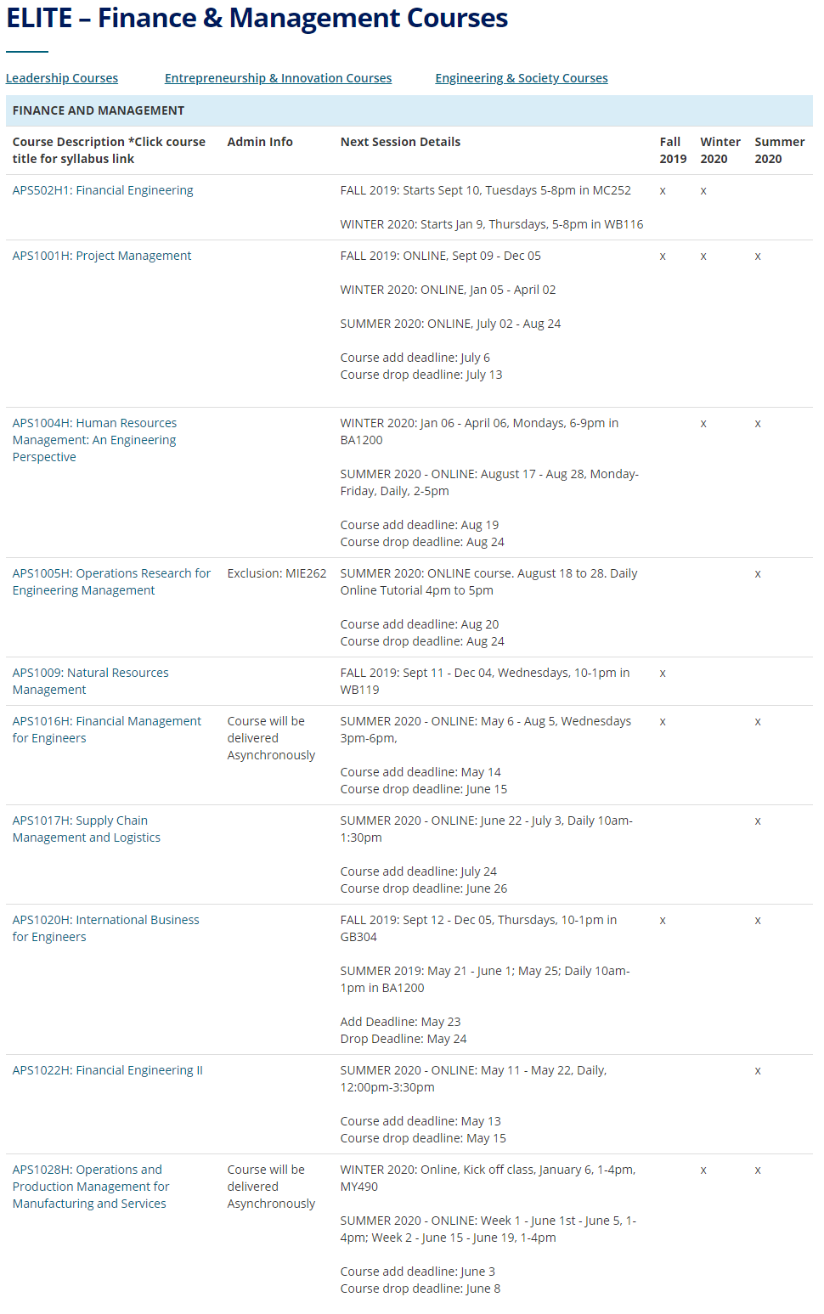
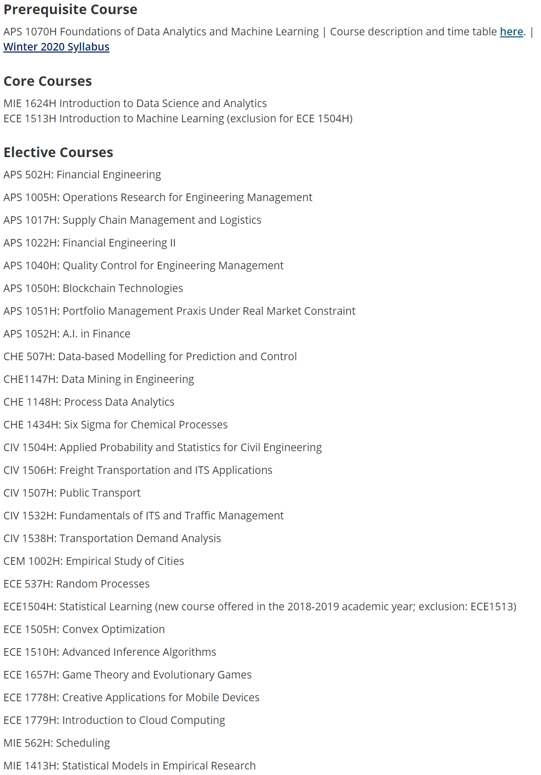
Motivations
Difficult for
Students to choose courses related to their interests and career.
The faculty to recommend courses to students
Course materials are not demanding and it is difficult to design new courses and programs.
The web page for emphasis is overwhelming and poorly organized.

Slide 3


Solution
Design a web Python APP using machine learning and data science:
Help faculty to design/update course curriculum based on current job demand and other existing online courses.
Help students to find interesting and useful course for their future career.

Slide 4
Design process
E. Repeat for other subjects and courses to generate a program curriculum
D. Design the course curriculum using these modules
C. Design course modules based on clustering results from web scrapings
A. Web scraping demanding job information
B. Web scraping course descriptions related to the job

Slide 5
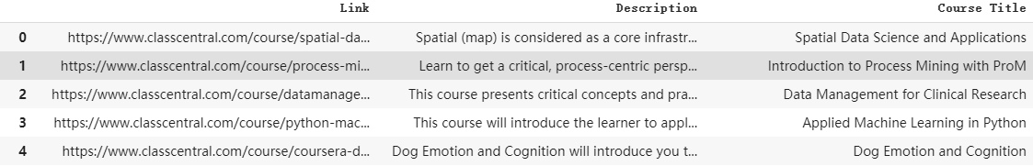






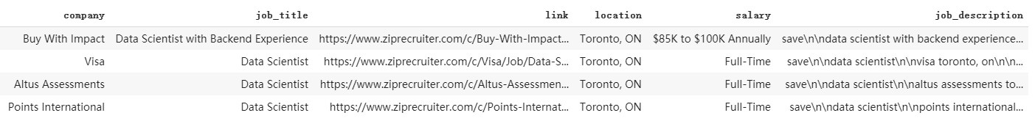
Data Collection by Web-Scraping
Job Search Websites: Indeed, Glassdoor, ZipRecruiter
Online Course Platforms: Coursera, Class Central, Course Report
Key Words: Data Analyst, Data Scientist/Engineer, Data Science
Scrapped Contents: Job/Course Descriptions, Titles
Online-Course Platforms
Job Market

Slide 6
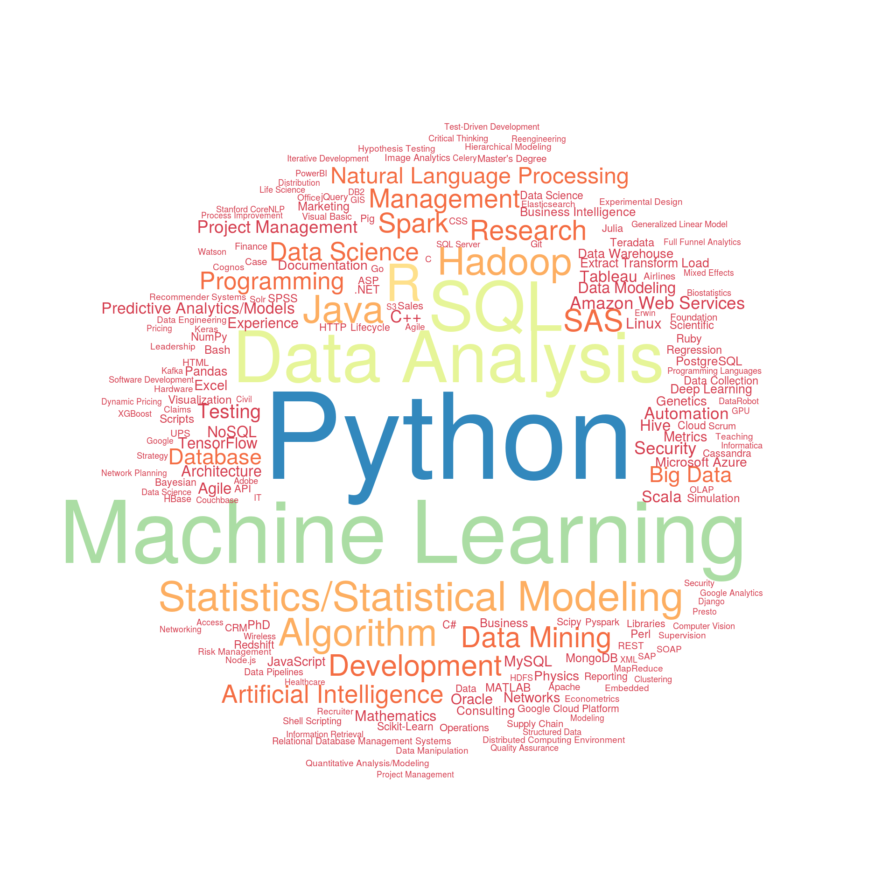
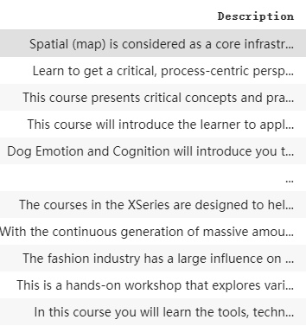
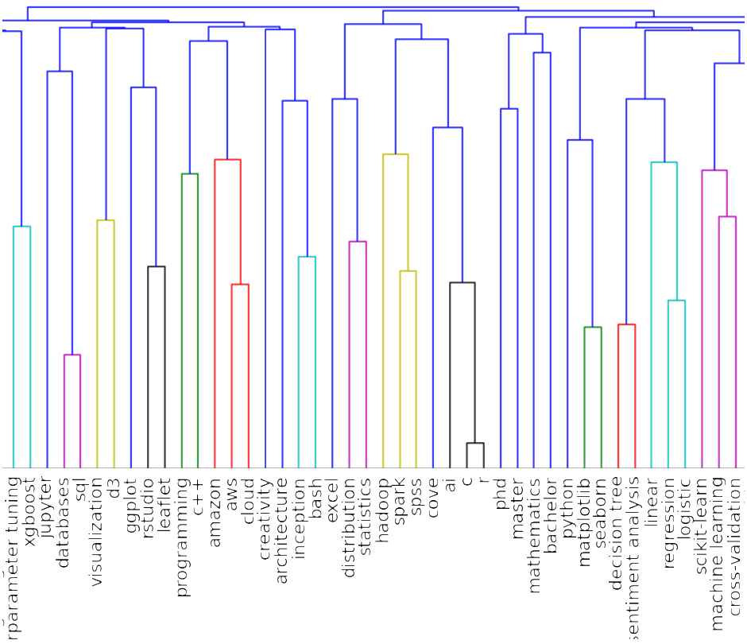
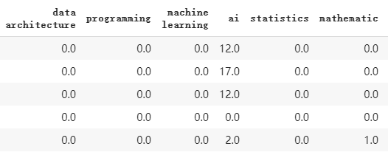
Data Cleaning and Clustering
Defining the skill sets of data science from WordCloud and Kaggle dataset.
2. Searching for the defined skills in each of the courses or job posting.
Calculating the word frequency of each skills in every observation.
Clustering the skills by Hierarchical Clustering using Dendrogram.
Finding the correlation between skills
Skills-Vectorization
Clustering
Description Table
Word Frequency Table
Dendrogram

Slide 7
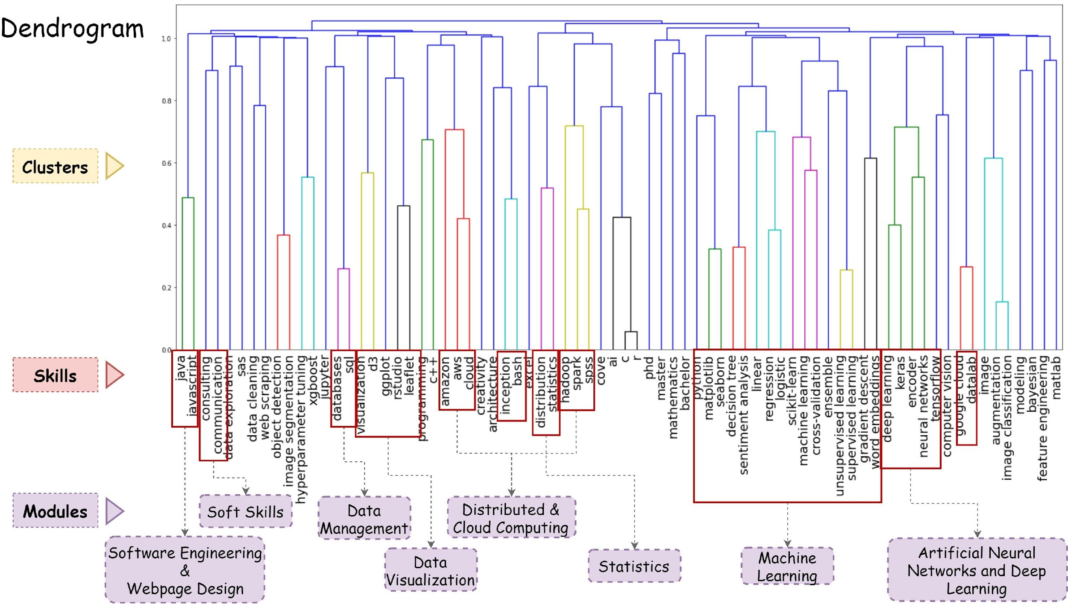

Slide 8
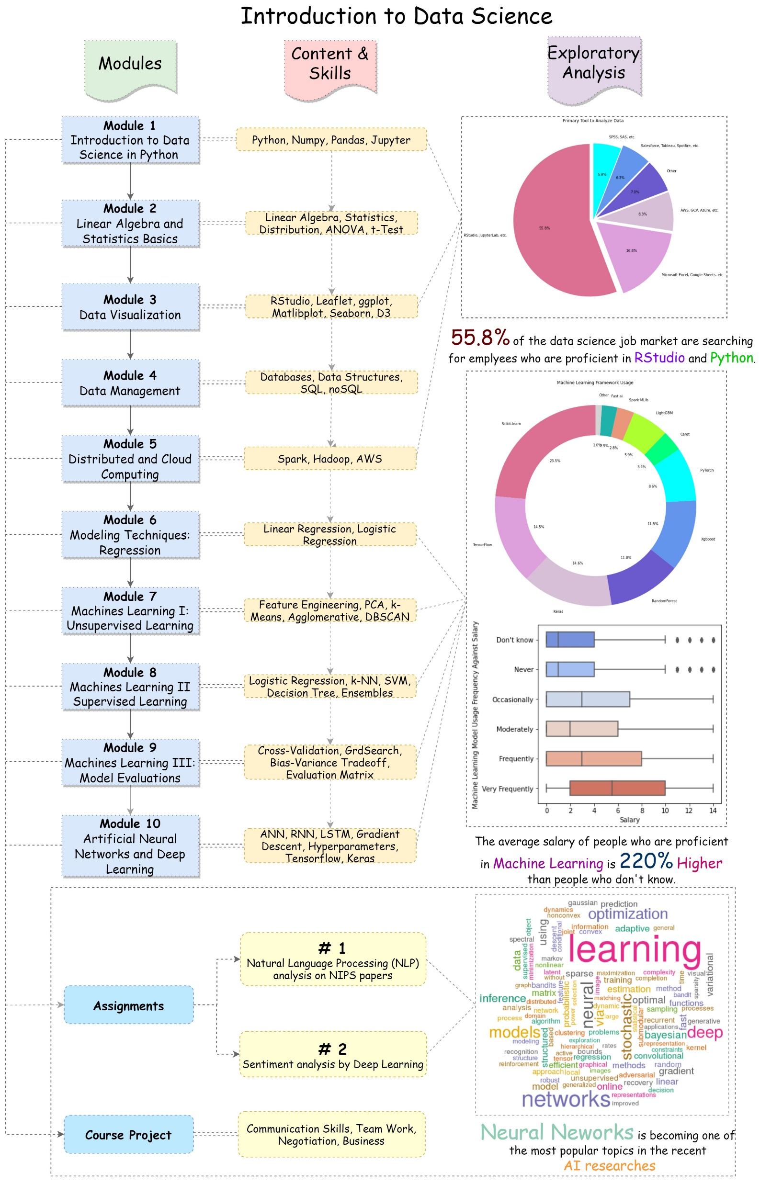
Core Course
- Introduction to Data Science
Course Description/Purpose:
Introduction to every possible aspects of data science.
Emphasize the essential skills in job market.
Provide real-word technical problem solving experience.
Explore the applications of data science in real-world.
Provide resources for students pursuing data science career in the future.
Soft-skills and business sense training by accomplishing business-oriented group projects.
Course
Modules
Practical
Projects

Slide 9

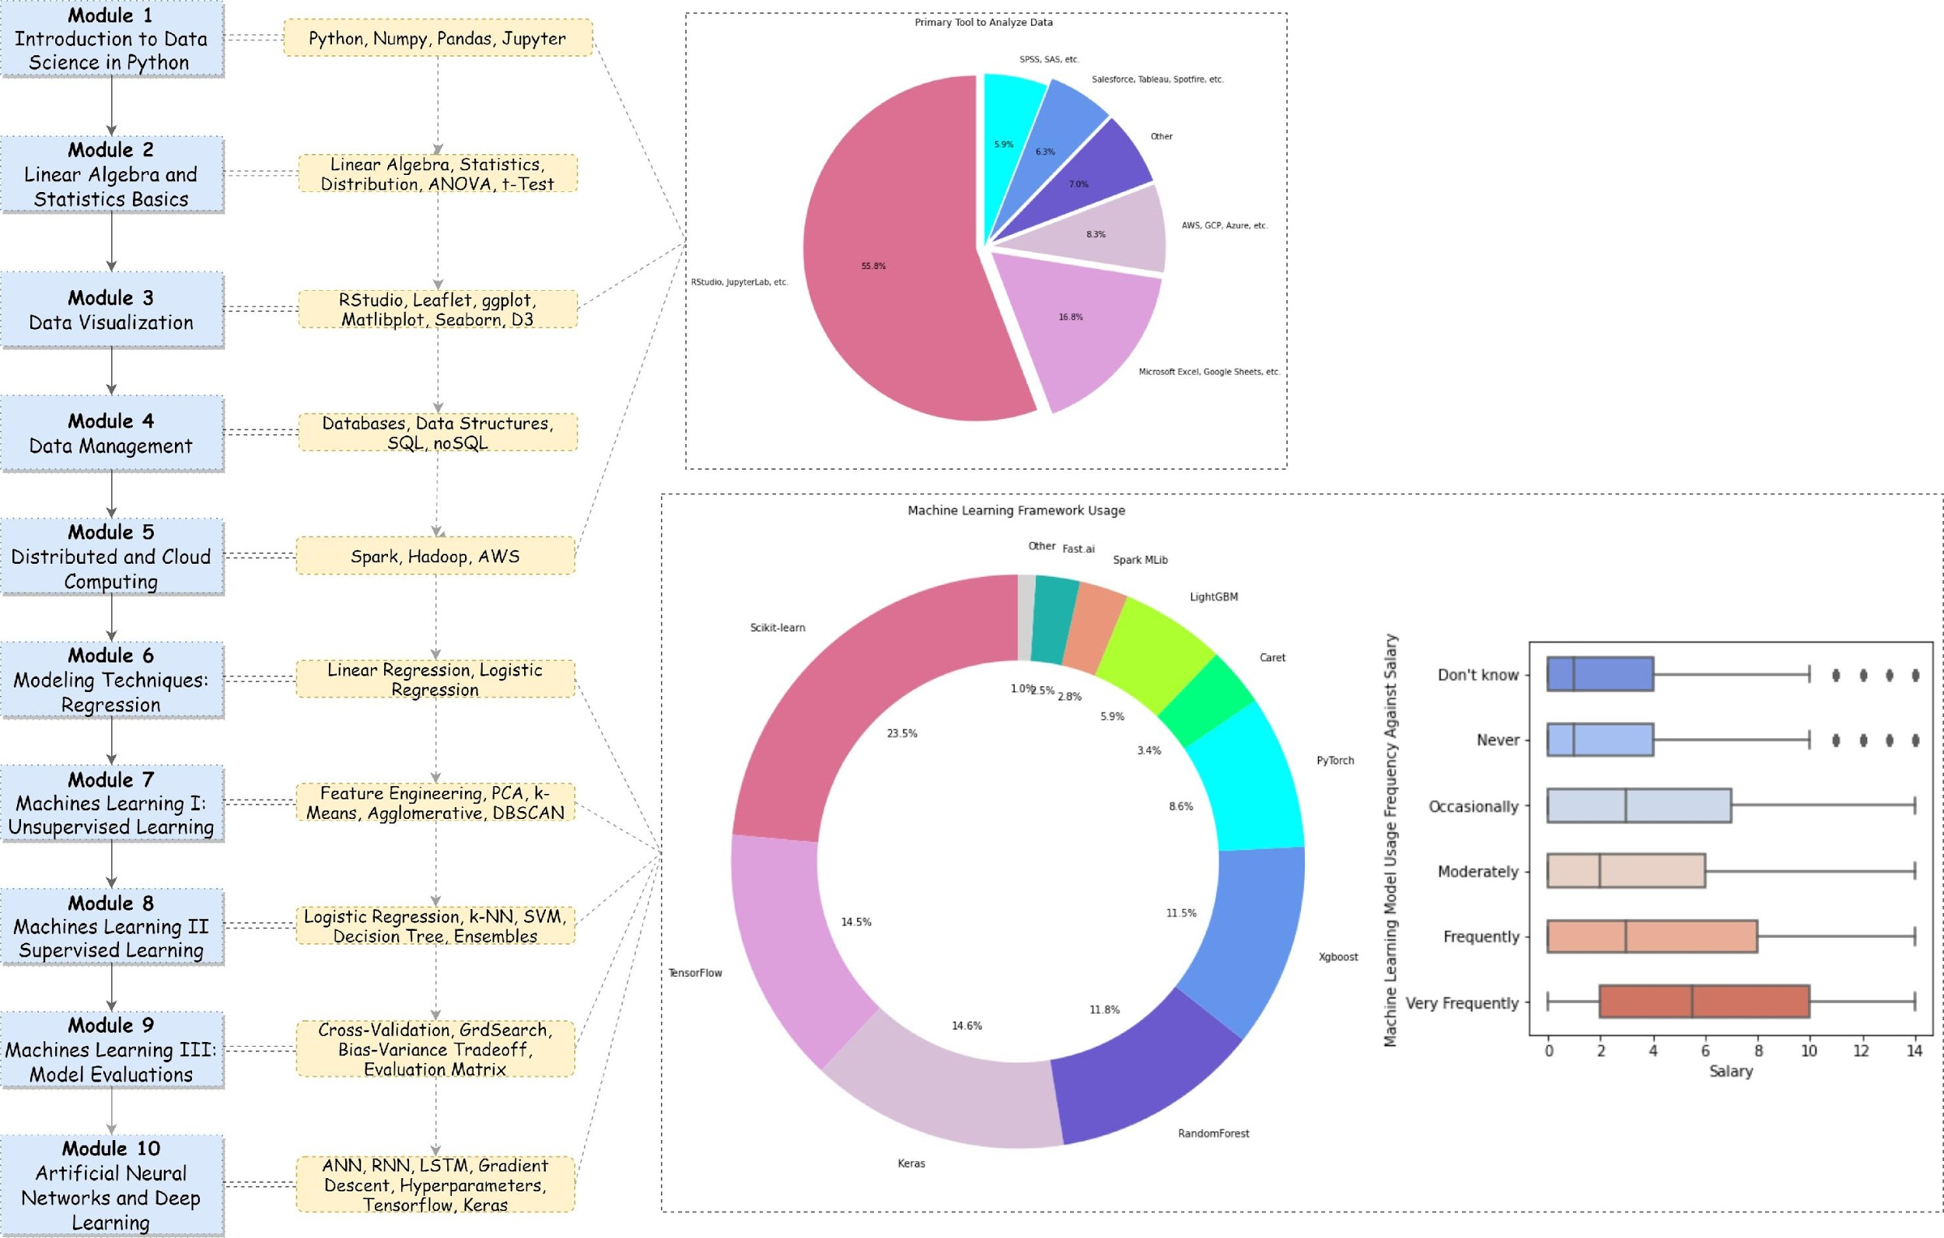
Exploratory Analysis- Course Modules
Course Modules are selected from skill clusters.
Python and Rstudio are the most frequently-used tool to analyze data
Sklearn, Tensorflow and Pytorch are the most popular machine learning frameworks.
The proficiency in machine learning is highly correlated to the salary level.

Slide 10
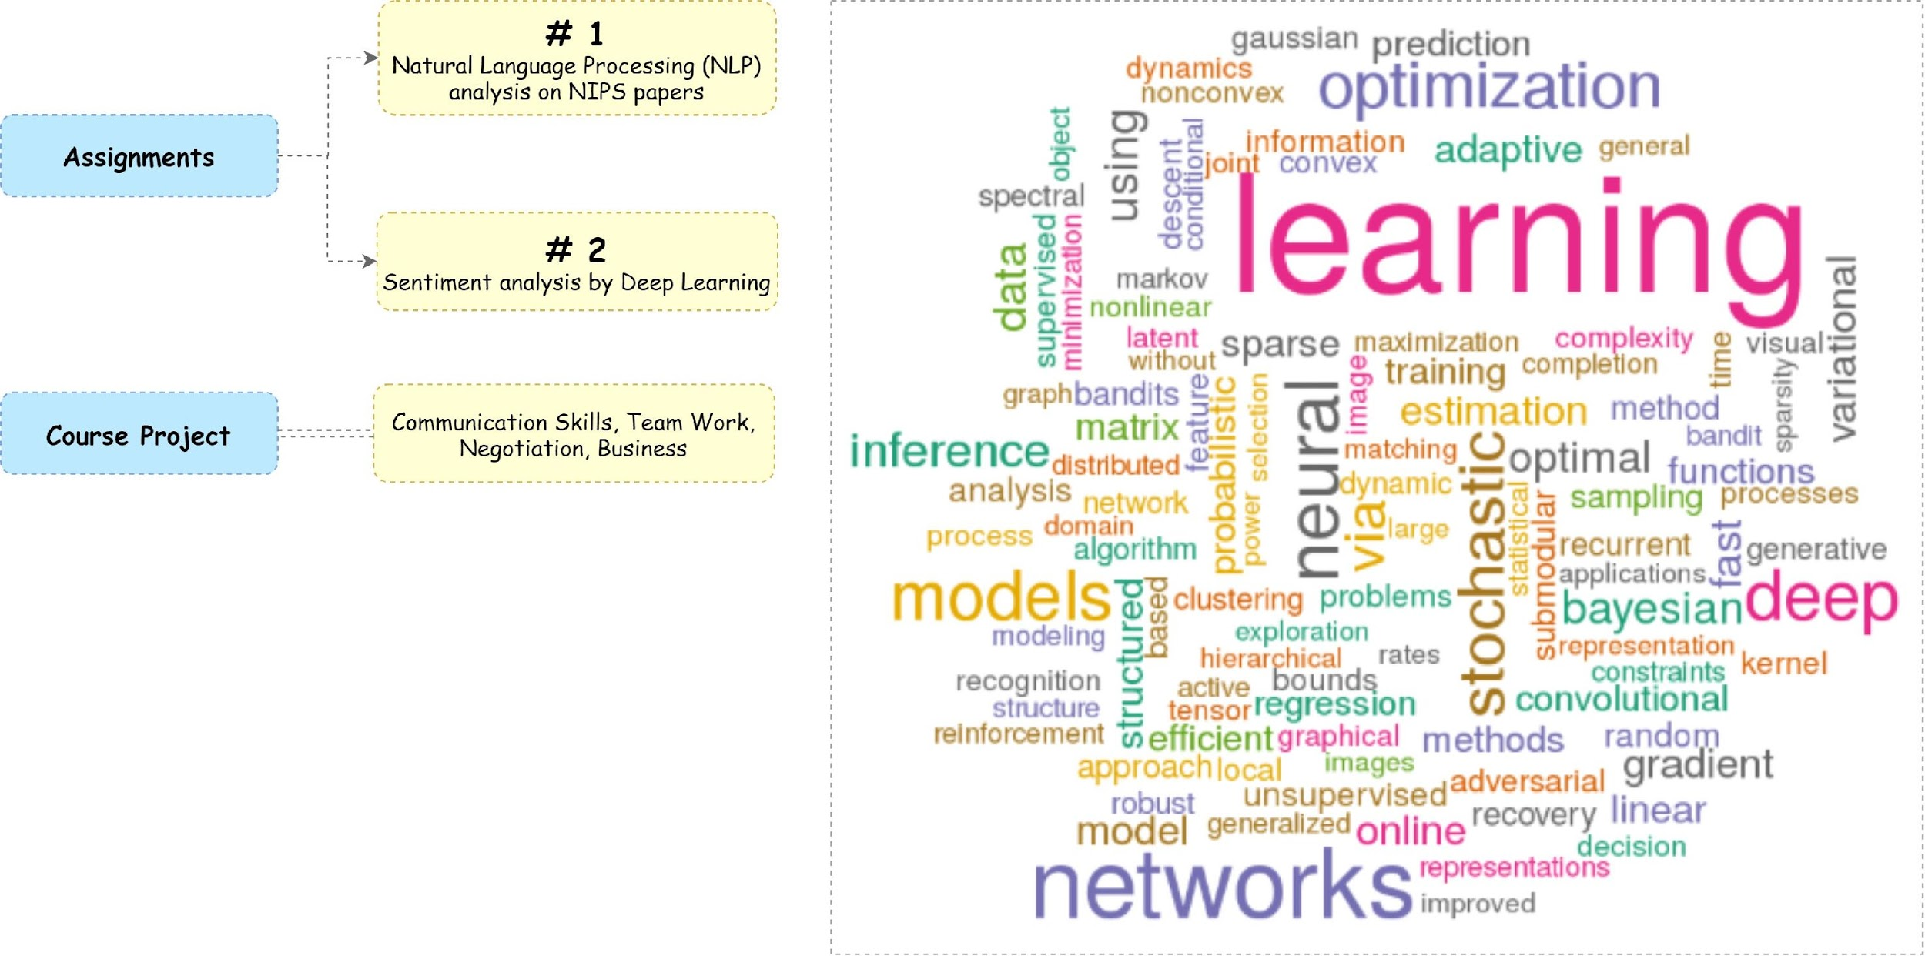
Exploratory Analysis- Course Projects
Assignments will focus on the most popular topics of artificial intelligence, such as NLP, sentiment analysis and deep learning.
Group project is intended to teach students with the business-oriented soft skills.
WordCloud of the most recent research topics analyzed from NIPS

Slide 11
Program Curriculum Overview
1. Introduction to Python Programming
5. Advanced Machine Learning
3. Introduction to
Data Science
2. Introduction to Finance
6. A.I. in Finance
4. Introduction to Statistics and Analytics

Slide 12
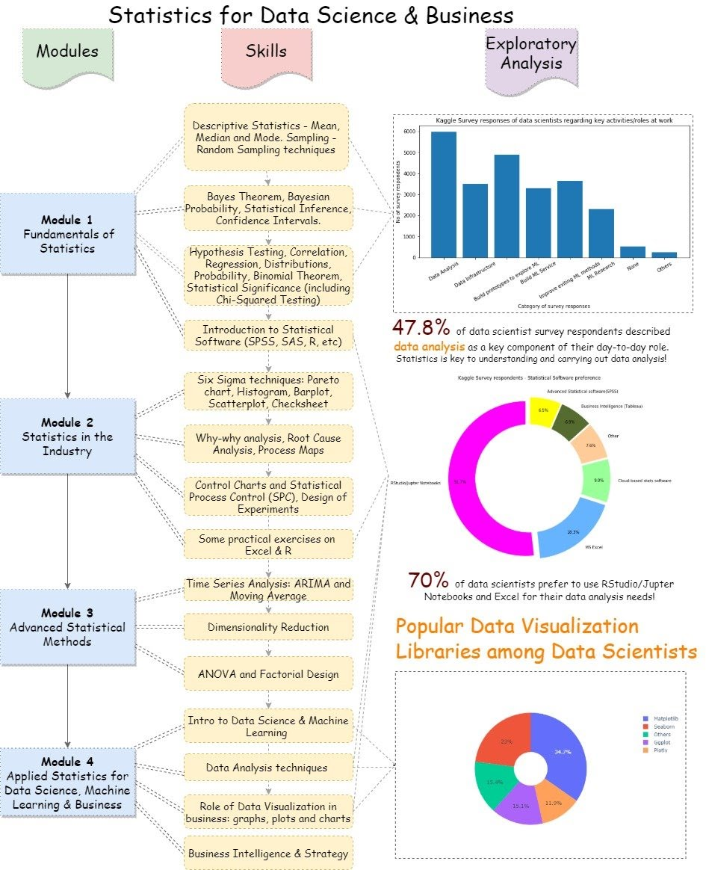
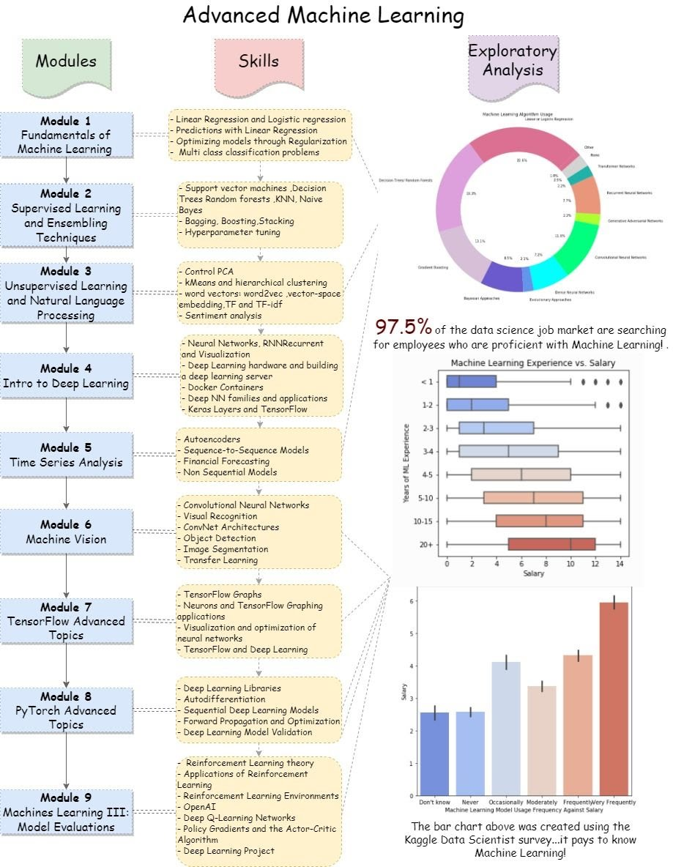
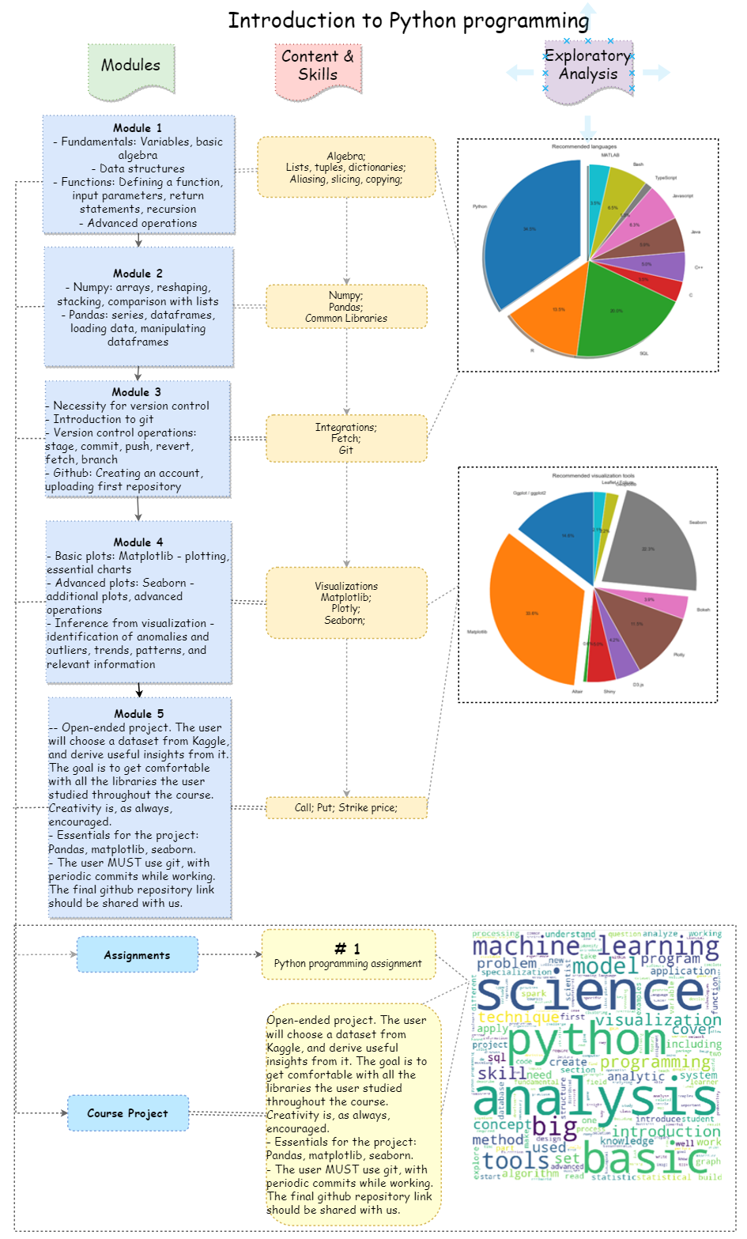
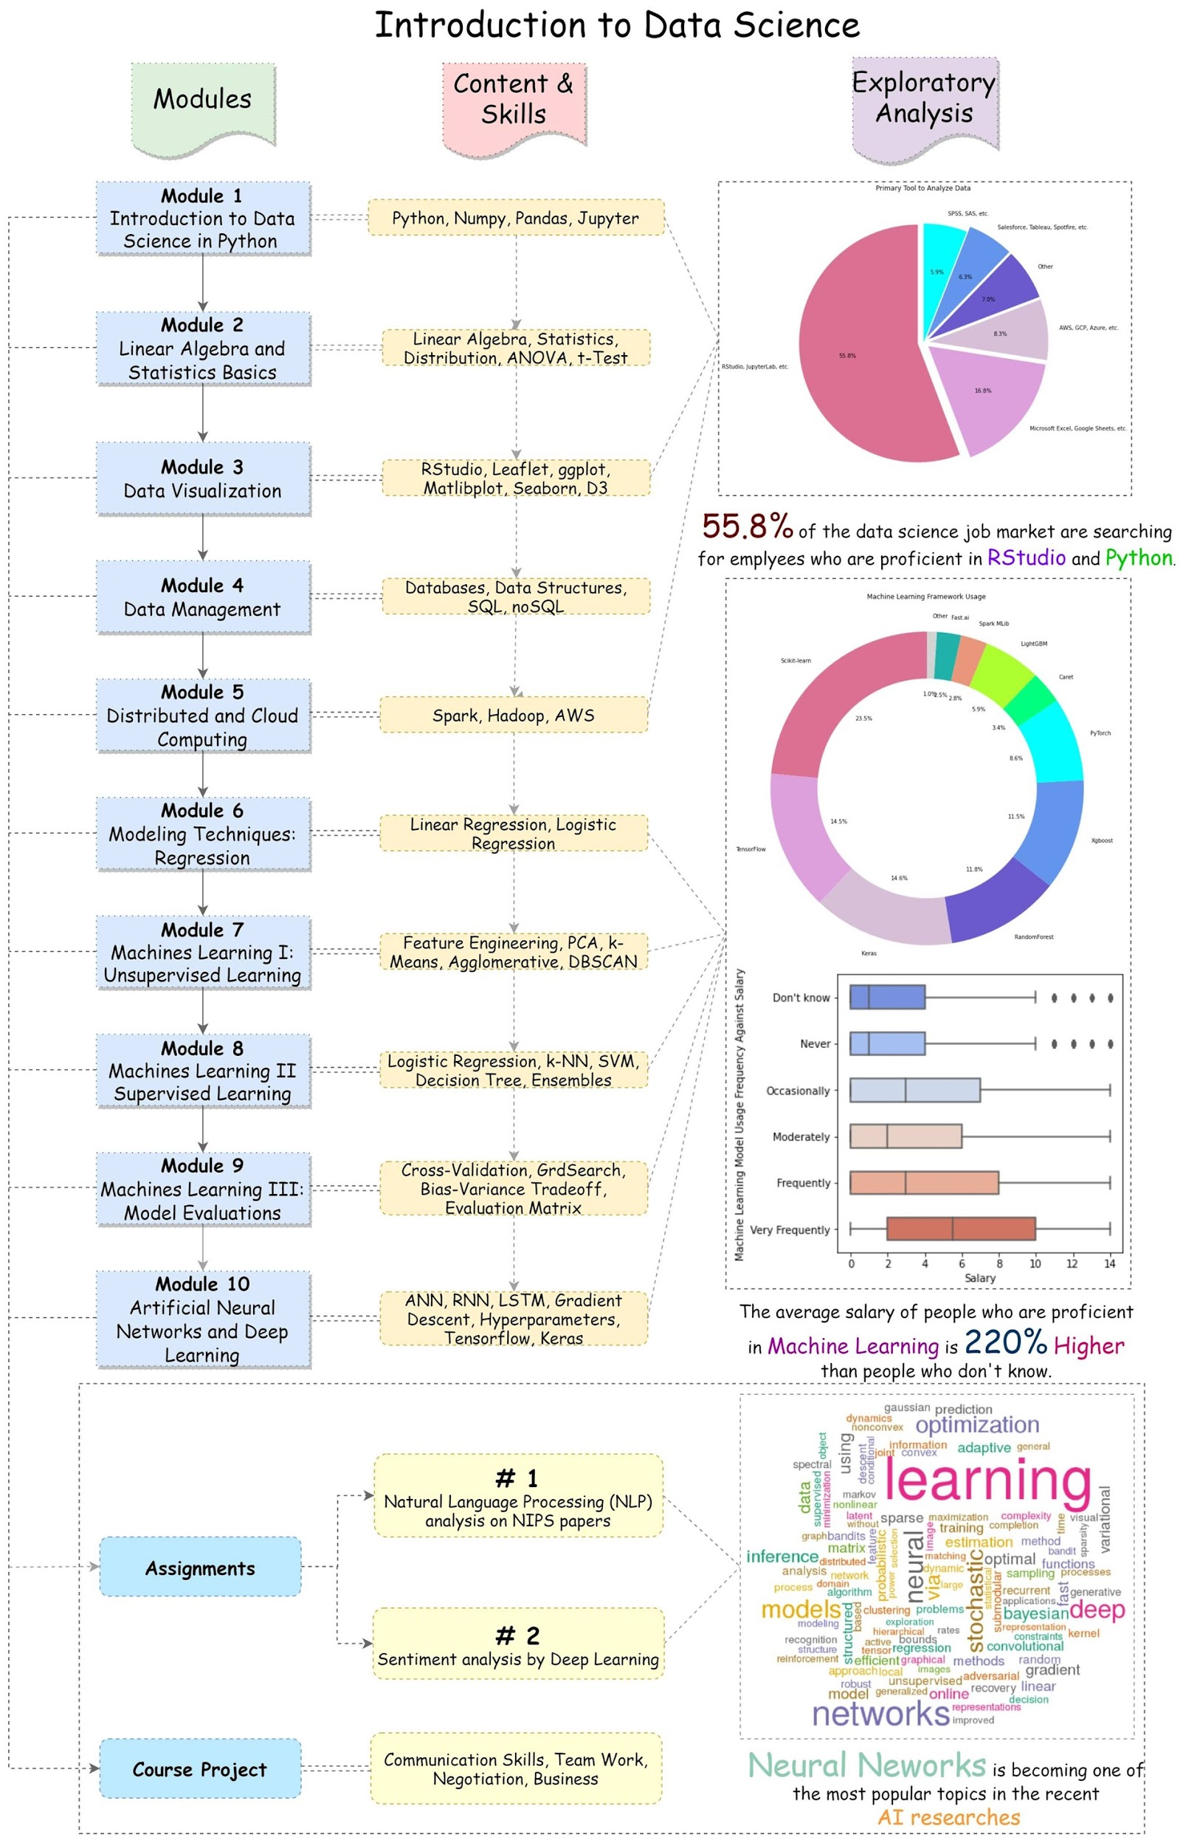
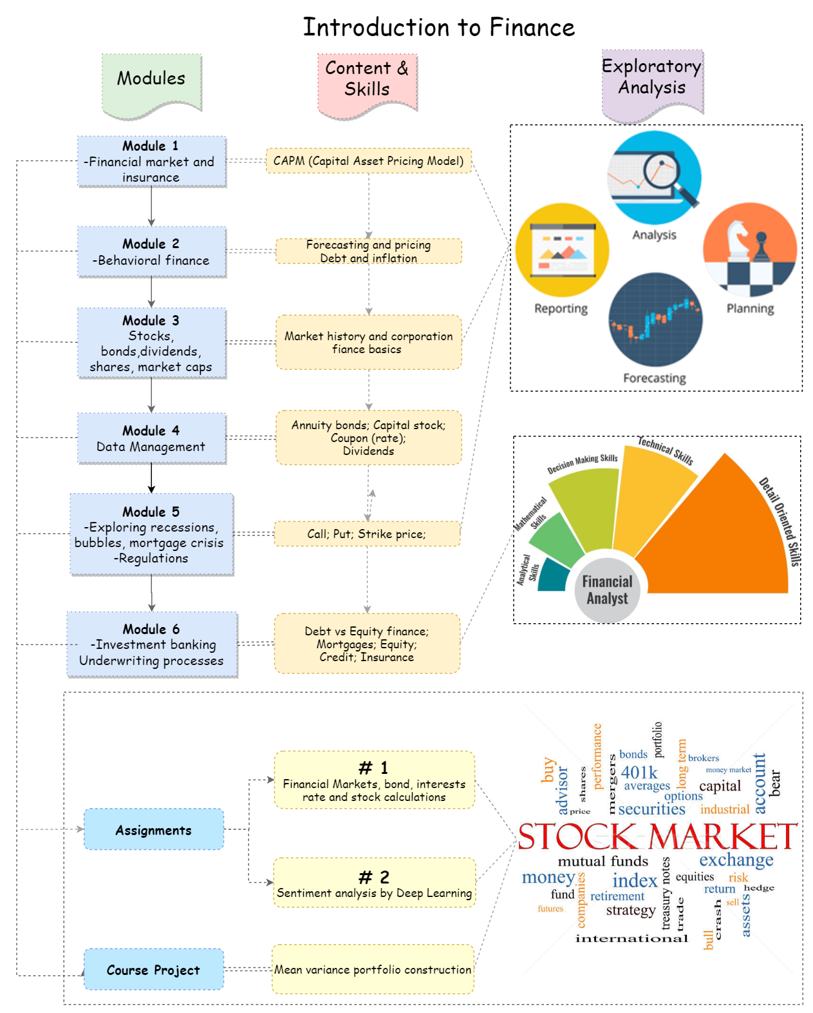
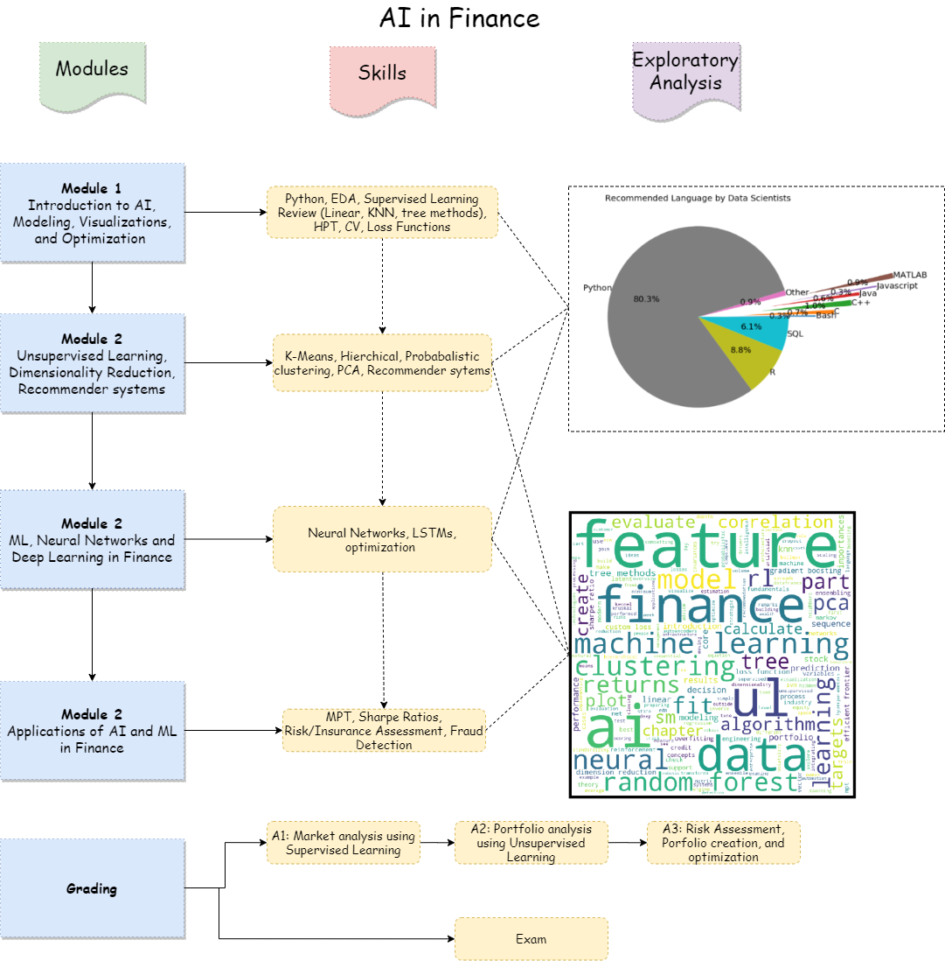
Course curriculum

Slide 13
Business Question
Now that the core courses and curriculum have been set, finding the correct set of complementary courses poses a new challenge
How can we help students effortlessly choose electives?
How can we help students using online education platforms ?

Slide 14
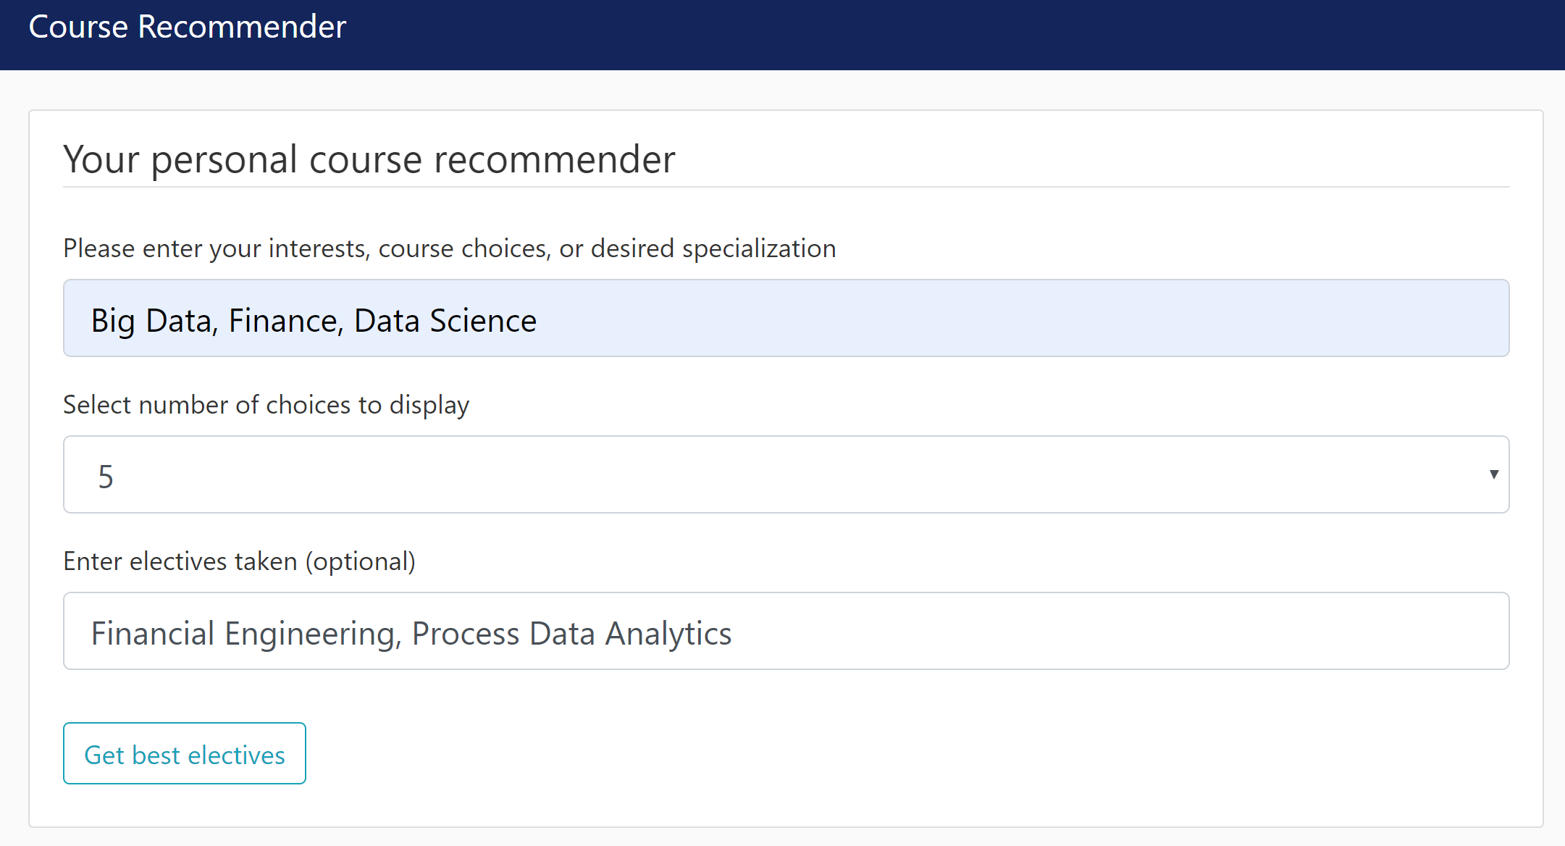
SOLUTION: Course Recommender!
Recommends electives based on the students interests, or desired specialization
Can also suggest electives similar to a course already taken
Personalizes the elective search by filtering courses relevant to the user key words
Filters out previously taken courses from recommendation
Recommends top rated online courses using dream job as input

Slide 15
SWOT Analysis
Quick and robust application
Pricing (free!)
Easy to use
Highly scalable
Small business, inexperience
Recommender system requires accurate course descriptions
S
Strengths
W
Weaknesses
System can be integrated to other school
Additional features - weighting interests, more visuals
Use of Deep learning for more accuracy
Required funds to scale the project
University restrictions (?)
Laws on scraping/information gathering
O
Opportunities
T
Threats

